Slide 1
New Challenges in Cloud Datacenter Monitoring and Management

Slide 2
Agenda
Background
Challenges in Cloud Monitoring
System-level
User-level
Network-level
Conclusions and Future Work
Cloud Management Related Work

Slide 3
Background
Complexity and Mission Criticalness of Cloud
Scale and diversity of the infrastructure
Servers, network devices, storages, etc.
Hundreds, even thousands of machines
Massive number of user applications
Catastrophic consequence of failure / security breach / performance degradation
Monitoring is indispensable
Availability, failure detection
Performance, provisioning
Security, anomaly detection
Application-level monitoring

Slide 4
Background
Delivering Monitoring-as-a-Service
Similar to other cloud services
Database service (e.g. SimpleDB, Datastore)
Storage service (e.g. S3)
Application service (e.g. AppEngine)
Various benefits
End-to-end support, easy to use
Well maintained, reliable service
Sharing of implementation (template implementation)

Slide 5
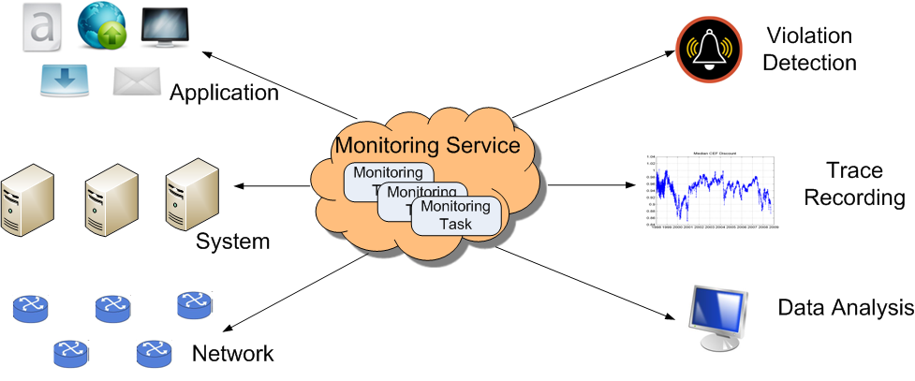
Background
A high-level view of the cloud monitoring service

Slide 6
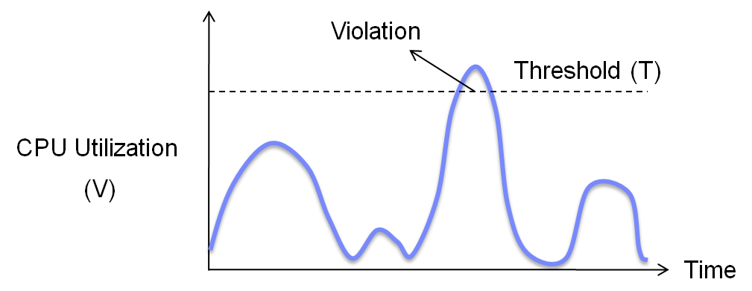
Background
State Monitoring
Monitoring the state of a system / application / service
State definition: a scalar value describes a certain state, V
E.g. CPU utilization, average response time, etc.
Violation: V > T

Slide 7
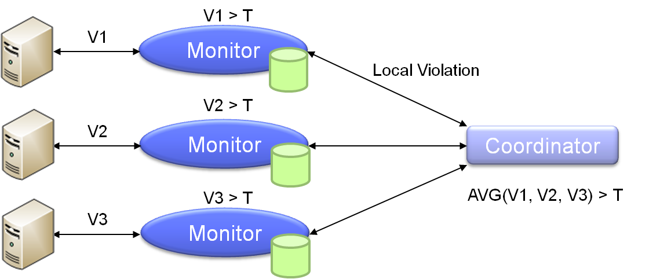
Background
Distributed State Monitoring
State value V is aggregated across multiple objects
Monitor and coordinator
An example of web server monitoring (average CPU utilization)

Slide 8
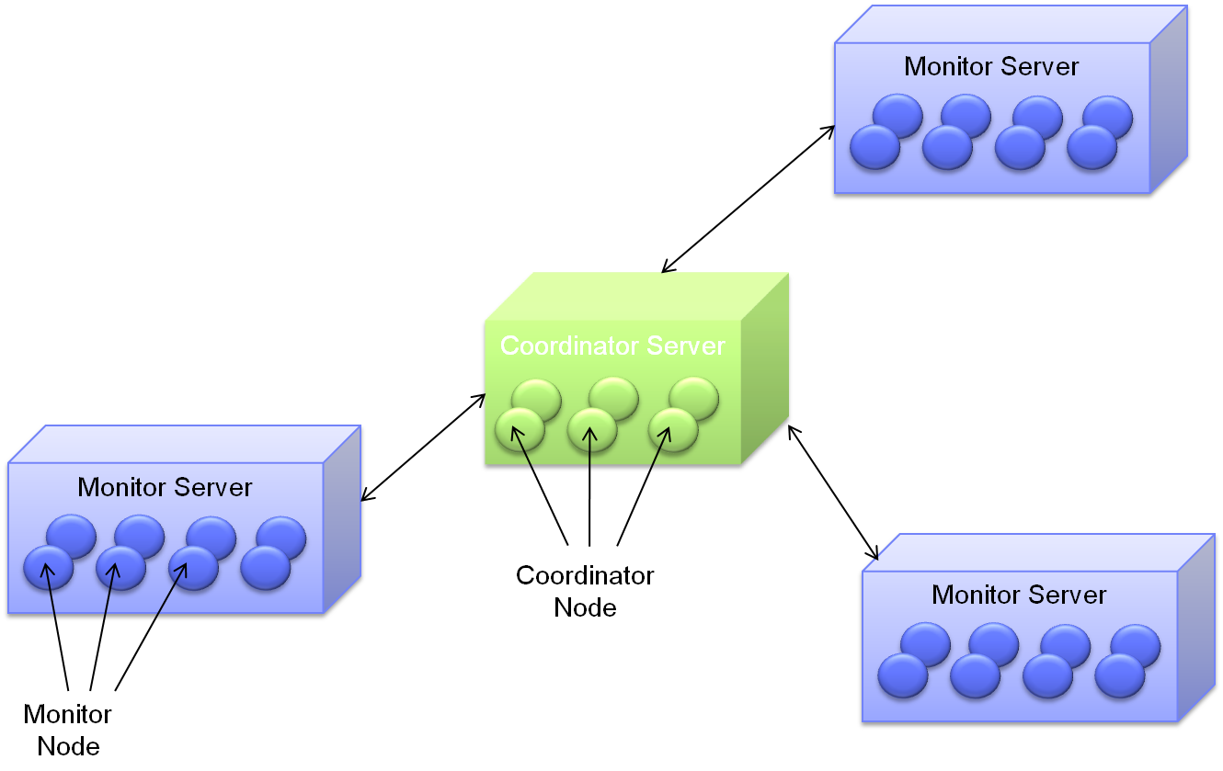
Background
Architecture
Monitor Server
Coordinator Server

Slide 9
Challenges at System Level
Efficient Scalability
Supporting tens of thousands of monitoring tasks
Cost effective: minimize resource usage
Monitoring QoS
Multi-tenancy environment
Minimize resource contention between monitoring tasks

Slide 10
Efficient Scalability
Massive Scale
Many monitoring tasks are inherently large scale
E.g. SLA monitoring
A large number of users
Infrastructure monitoring
Application monitoring
Monitoring tasks with high cost
E.g. Distributed heavy hitter detection based on netflow data
Cost Effectiveness
Monitoring is a facilitating service
Use few machines as possible

Slide 11
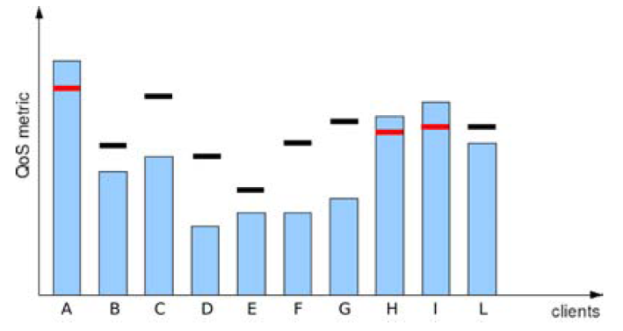
Efficient Scalability
Observation
Not every task need intensive monitoring
One task may not need intensive monitoring all the time

Slide 12
Efficient Scalability
Violation Likelihood Driven Adaptation
Perform intensive monitoring
Only for tasks with high violation likelihood
Only when the violation likelihood of the task is high
Efficient violation estimation based on the sampled value change δ
Reduce sampling frequency if violation likelihood less than an error allowance
Monitored Value
V2
V1
δ
Time

Slide 13
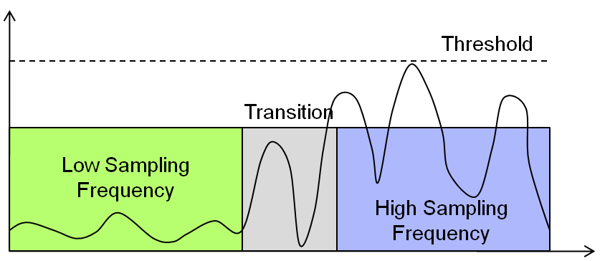
Efficient Scalability
Handling Changes of Distribution
Distributing error allowance among multiple monitor node
Error Allowance

Slide 14
Efficient Scalability
Results

Slide 15
Challenges at System Level
Efficient Scalability
Supporting tens of thousands of monitoring tasks
Cost effective: minimize resource usage
Monitoring QoS
Multi-tenancy environment
Minimize resource contention between monitoring tasks

Slide 16
Quality-of-Service
Implication of Multi-Tenancy
Monitoring tasks: adding, removing
Resource contention between monitoring tasks
Understanding the impact of resource contention
Let’s first look at the implementation of monitor server …

Slide 17
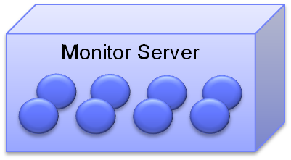
Quality-of-Service
Threading on Monitor Servers
Performance and scalability goals
Naïve implementation
Per-node thread
Potential large number of simultaneous monitoring tasks
high threading cost
Thread pool based implementation
Global scheduling for all monitor nodes within one server
Triggers for sampling and distributed condition evaluation
Scalability: sorted triggers
Thread pool

Slide 18
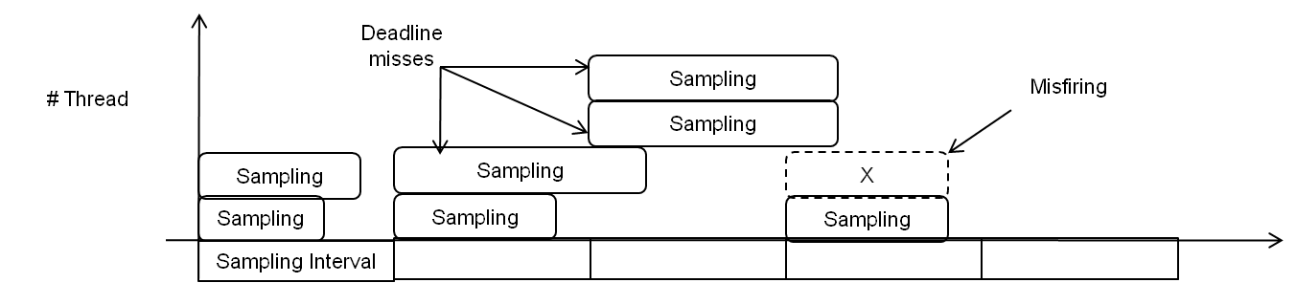
Quality-of-Service
Impact of resource contention
Sampling job may take longer time to finish (mis-deadlines)
Some monitoring tasks may miss sampling points (misfiring)

Slide 19

Quality-of-Service
Challenges in Resolving Resource Contention
Average resource utilization is not sufficient
May lead to wrong decision
Monitor nodes of the same task must be scheduled to execute at the same time.
Time shift should be minimized
60 secs
60 secs
60 secs
60 secs
60 secs
60 secs

Slide 20
Quality-of-Service
Challenges in Resolving Resource Contention
Average resource utilization is not sufficient
May lead to wrong decision
Monitor nodes of the same task must be scheduled to execute at the same time.
Time shift should be minimized
60 secs
60 secs
60 secs
60 secs
60 secs
60 secs

Slide 21
Quality-of-Service
Challenges in Resolving Resource Contention
Average resource utilization is not sufficient
May lead to wrong decision
Monitor nodes of the same task must be scheduled to execute at the same time.
Time shift should be minimized
60 secs
60 secs
60 secs
60 secs
60 secs
60 secs

Slide 22
Quality-of-Service
Challenges in Resolving Resource Contention
Average resource utilization is not sufficient
May lead to wrong decision
Monitor nodes of the same task must be scheduled to execute at the same time.
Time shift should be minimized
60 secs
60 secs
60 secs
60 secs
60 secs
60 secs

Slide 23
Quality-of-Service
Approach Intuition
Capturing patterns of
Monitoring task resource usage
Server resource availability
Matching usage pattern and availability pattern efficiently
50%-80% reduction in mis-deadlines and misfiring

Slide 24
Challenges at User Level
Budget-Aware Monitoring
Allow dynamic monitoring resolution based on available budget
Distributed Continuous Violation Detection
Meets the need of different detection model
Achieve efficiency at the same time

Slide 25
Budget-Aware Monitoring
Cloud and “Pay-as-You-Go”
Directly associate computing cost with monetary cost
Allow flexible provisioning based on available budget
Overhead in Cloud Monitoring
Violation processing cost
E.g. provisioning new servers when detects performance degradation
Also consumes cloud users’ budget
What does existing monitoring techniques miss?
No connection between monitoring utility and monitoring cost
E.g. the budget consumption of a monitoring task is simply unknown…
Surprising bills are possible…
An ideal type of monitoring

Slide 26
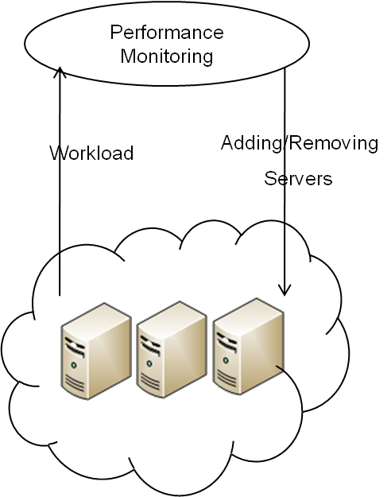
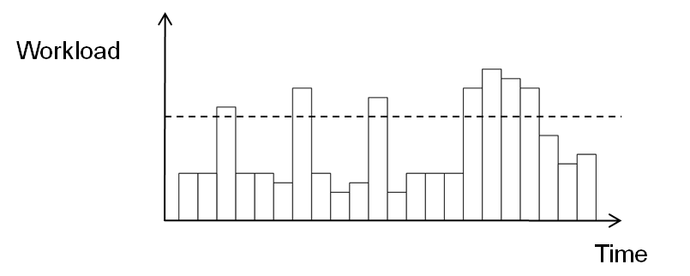
Budget-Aware Monitoring
Why we need a new interface?
Web application auto-scaling
Dynamically adding/removing servers
based on performance
Given a budget, how should we configure
the monitoring task?

Slide 27
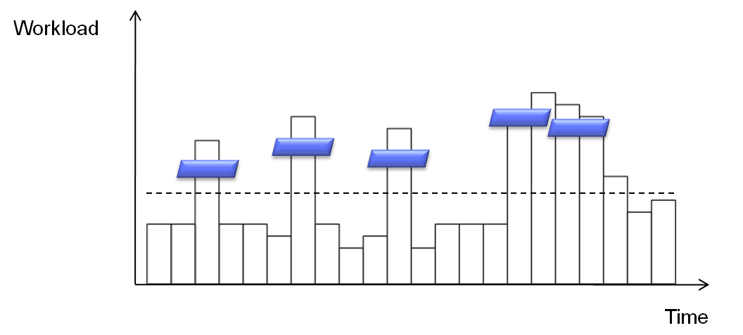
Budget-Aware Monitoring
Monitoring Resolution
Granularity of monitoring
We propose to use sliding time windows to control monitoring resolution
E.g. average all sample values within the window

Slide 28
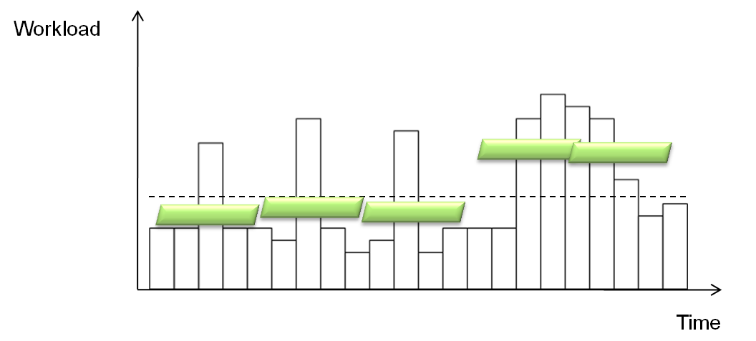
Budget-Aware Monitoring
Monitoring Resolution
Granularity of monitoring
We propose to use sliding time windows to control monitoring resolution
E.g. average all sample values within the window

Slide 29
Budget-Aware Monitoring
How does budget-aware monitoring work?
Determine monitoring resolution based on available budget
When budget is abundant
Using fine monitoring resolution
Detect both trivial and important violation
When budget is limited
Using coarse monitoring resolution
Detect less but important violation

Slide 30
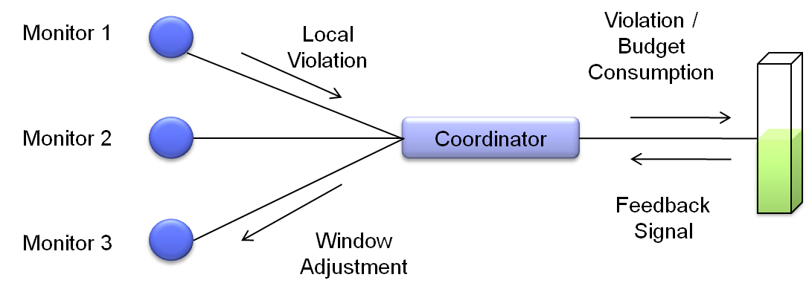
Budget-Aware Monitoring
Approach Sketch
Results summary
Auto-scaling experiment with RUBiS on emulab
20% - 40% reduction in response time

Slide 31
Challenges at User Level (Brief)
Distributed Continuous Violation Detection
Instantaneous detection model
Continuous detection model
Small difference in model, big difference in distributed processing
L
L
Short-term burst
Persistent violation

Slide 32
Challenges at Network Level (Brief)
Resource-Aware Monitoring Fabric
Monitoring the functioning of both systems and applications running on large-scale distributed systems
Continuous collecting detailed attribute values
A large number of nodes
A large number of attributes
Overhead increases quickly as the system, application and monitoring tasks scales up.
Goal
Organizing nodes into a monitoring overlay
Per-node resource constraint is not violated
Maximize the number of values to be collected

Slide 33
Conclusions and Future Work
Conclusions
Monitoring-as-a-service
Brings various benefits to applications deployed in cloud
However, it is also difficult to deliver
Involves changes at almost all levels
We developed techniques to solve some of the problems
Require further study
Future Work
Monitoring API
Provisioning monitoring service and billing
Etc.

Slide 34
Cloud Management Related Work
Scalable Management Middleware for Virtualized Datacenters
Scalable and Cost-Effective IPTV Cloud

Slide 35
Thank You
Questions?

